Slide 2
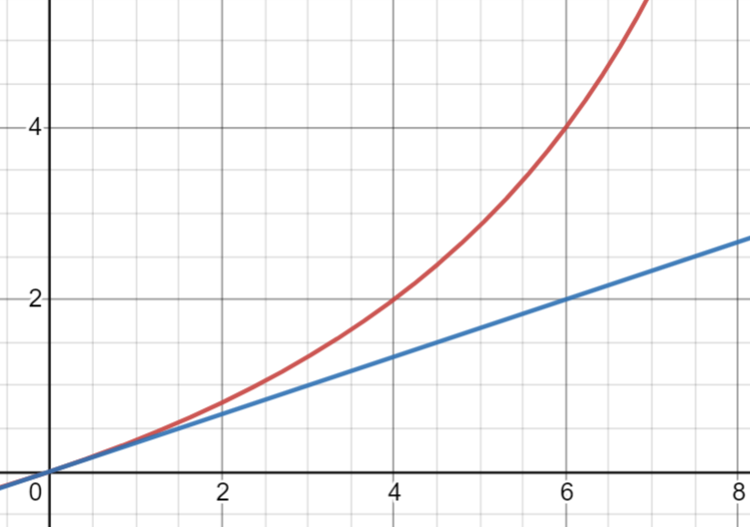
Red- van der Waals’ law
Blue- Ideal gas law
Pressure (N/m)
Particle number (N)

